Slide 1
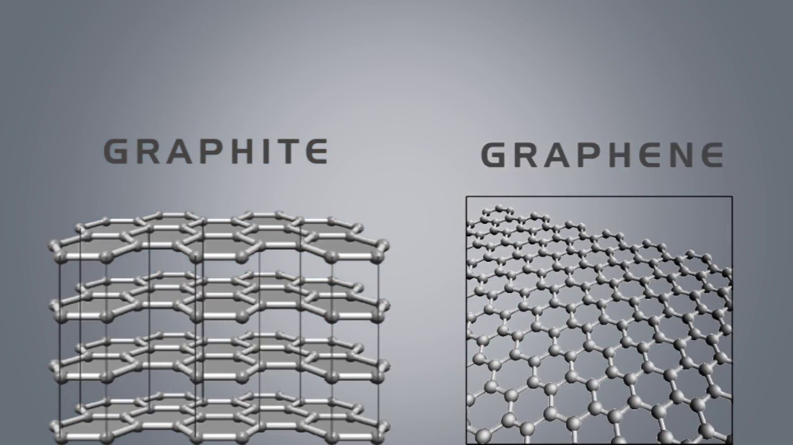

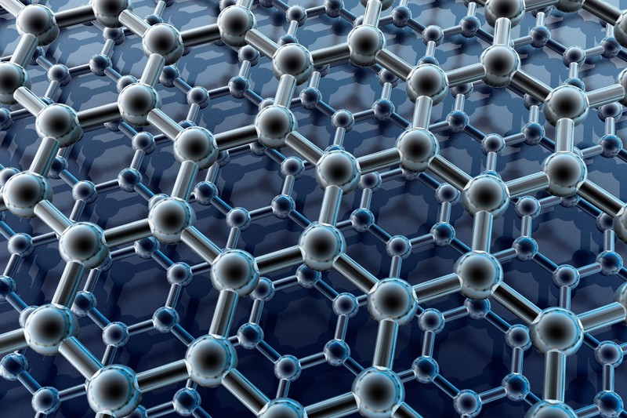
Graphene
ΠΑΝΕΠΙΣΤΗΜΙΟ ΚΡΗΤΗΣ
ΤΜΗΜΑ ΧΗΜΕΙΑΣ
ΚΑΡΝΗΣ ΙΩΑΝΝΗΣ Α.Μ. 1070
Μεταπτυχιακό μάθημα: Υπερμοριακή Χημεία
Υπεύθυνος καθηγητής: Κουτσολέλος Αθανάσιος

Slide 2
Short History
1916 →Graphite structure using powder diffraction
1948 → First TEM images of few-layered graphite (G. Ruess και F. Vogt)
1970s→Epitaxial growth of single-layered graphite on other materials
1990→Efforts to make thin films of graphite by mechanical exfoliation (50-100 στρώματα μέχρι το 2004)
2004→Extraction of single-atom-thick crystallites from bulk graphite (Andre Geim και Kostya Novoselov, The University of Manchester).Use of scotch tape to pull graphene layers from graphite and transfer onto thin SiO₂ on a silicon (Scotch tape technique)

Slide 3
Structure
Crystalline allotrope of carbon with 2-dimensional properties. Densely packed carbon atoms in a regular atomic-scale chicken wire(hexagonal) pattern
Each atom has four bonds, one σ and one π-bond. The atoms are about 1.42 ångströms apart
Graphene's hexagonal lattice can be regarded as two interleaving triangular lattices. This perspective was successfully used to calculate the band structure for a single graphite layer using a tight-binding approximation.
Great stability due to tightly packed carbon atoms and a sp² hybridization. The π-bonds hybridize to form the π-band and π∗-bands. These bands are responsible for most of graphene's notable electronic properties, via the half-filled band that permits free-moving electrons.
Graphene sheets in solid form usually show evidence in diffraction for graphite's (002) layering
Graphene can self-repair holes in its sheets, when exposed to molecules containing carbon(hydrocarbons). Bombarded with pure carbon atoms, the atoms perfectly align into hexagons

Slide 4
Mechanical exfoliation
Confirmation of the existence of graphene as a two- dimensional crystal(A. Geim and K. Novoselov in 2004, Nobel Prize in Physics in 2010).
Isolation of graphene sheets by adhesive tape and transfer to the desired substrate
Best quality of produced graphene
Disadvantageous in the control of shape and quantity.

Slide 5
Liquid phase exfoliation
Occurs with the help of solvents and / or surfactants and the imposi- tion of some external force in the process (ultrasonication, blender)
Improves the problem of the quantity produced
Degrades its properties as it is difficult to remove the solvents and / or surfactants
Use of materials, which will not affect the application of the graphene we desire.

Slide 6
Graphene oxide production (GO)
Greatly increases the amount produced
The oxidized sheets of graphene
  acquire the dispersion property in many solvents
  their remaining properties are dramatically reduced
The first method for GO production was made by Hummer in 1958 and several others have since been developed.

Slide 7
Epitaxial growth of graphene on silicon carbide (SiC) substrates
Takes place under high vacuum and high temperature conditions
Si atoms are sublimed and bonds are formed between the carbon atoms
Possible to check the number of layers and their size
The quality and energy requirements are the main drawbacks

Slide 8
Chemical Vapor Deposition, (CVD)
Control of size and quantity is best achieved
Degraded quality, however good enough
Graphene growth occurs on metallic surfaces (Cu, Ni)
High temperature and atmospheric conditions needed
Use of mixture of gases, typically 95% Ar, 5% H, carbon rich materials (methane)
Formation of bonds between the carbon atoms.

Slide 9
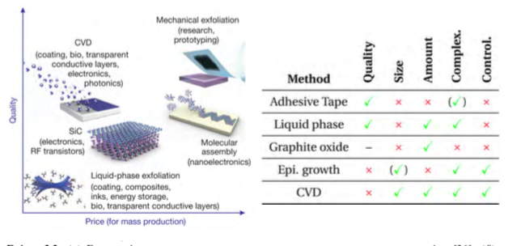

Slide 10
Forms
Mono-multilayer sheets
Graphene nanoribbons
Graphene oxide
Graphene ligand/complex
Pillared graphene
Graphene aerogel

Slide 11
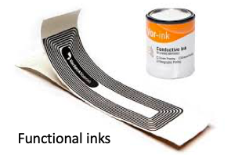
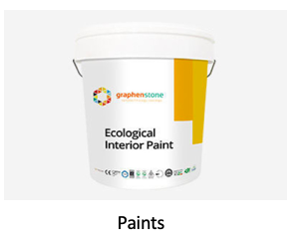
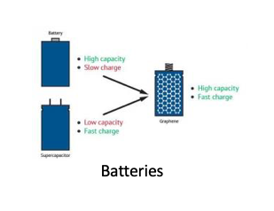
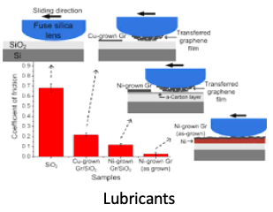
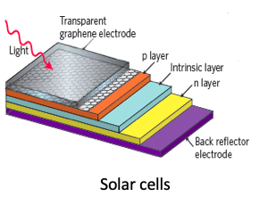
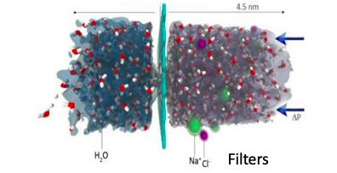
Uses

Slide 12
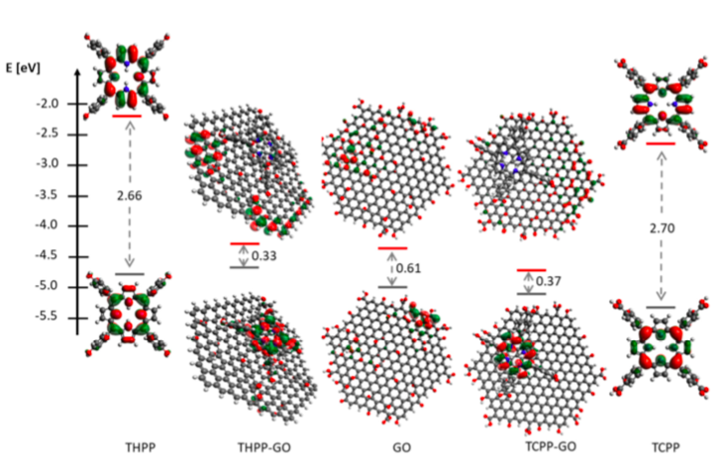
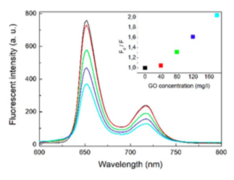
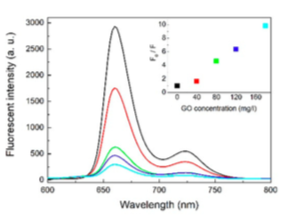
Graphene in suprachem
Merge of graphene with porphyrins
Change of properties
Use in photovoltaics, optoelectronics, and spintronics
THPP
TCPP

Slide 13
Βιβλιογραφία
K.S. Novoselov, et al., A roadmap for graphene. Nature, 2012. 490(7419): p. 192-200.
A.K. Geim, and K.S. Novoselov, The rise of graphene. Nat Mater, 2007. 6(3): p. 183-191.
Kornelia Lewandowska et al., Supramolecular Complexes of Graphene Oxide with Porphyrins: An Interplay between Electronic and Magnetic Properties, Molecules, 2019

